Slide 1
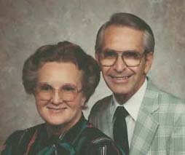
The Church Legacy
By Daniel Scott
An Experience In Church History

Slide 2
The Seven Periods In Church History
An Introduction To The Study
The Apostolic
Church Birth to Today’s Church

Slide 3
The Seven Periods In Church History
1) Period of Development
A.D. 27 – 30
Covers the Gospels to Acts 1
Begins with Selecting the Disciples
Ends with Jesus giving the Great Commission
The ascension of Jesus Christ

Slide 4
The Seven Periods In Church History
2) Period of Organization
A.D. 30 – 37
Covers Acts 2 through Acts 7
Begins with Birth of the Church
Ends with Persecution scattering the church
Jerusalem established as the Center of Evangelism

Slide 5
The Seven Periods In Church History
3) Period of Transition
A.D. 37 – 48
Covers Acts 8 through Acts 12
Begins with Evangelism outside Jerusalem
Ends with Gentiles accepted in the church as equals
Jerusalem continues as the Center of Evangelism

Slide 6
The Seven Periods In Church History
4) Period of Expansion
A.D. 48 – 67
Covers Acts 13 through Acts 28
Missionaries called to carry the gospel
Ends with the martyrdom of Paul in Rome
Antioch becomes the Center of Evangelism

Slide 7
The Seven Periods In Church History
5) Period - Doctrinal Protection
A.D. 67 - 100
the protection of Apostolic Doctrine
Begins with entering of false teachers
Ends with the Death of the Apostle John
Legacy of Apostolic Doctrine given to a new generation of martyrs

Slide 8
The Seven Periods In Church History
6) Period of Doctrinal Conflict
A.D. 100 – AD 1832
the Apostolic Doctrine Challenged
Begins with the martyrdom of Polycarp
Rise and Power of the Catholic Church
Ends with the Revival of Glasgow, Scotland

Slide 9
The Seven Periods In Church History – Part 1
7) Period of Restoration
A.D. 1832 – AD 1900
the Holy Spirit Baptism Restored
Begins with the Edward Irving
Ends with the Outpouring of the Holy Spirit in Azusa Street
Speaking with tongues as evidence of Holy Spirit baptism

Slide 10
The Seven Periods In Church History – Part 2
7) Period of Restoration
A.D. 1906 – Present
Begins with the Camp Meeting Arroyo Seco
Baptism in the name of Jesus Christ Restored
the Apostolic Doctrine being restored – A Mirror of Pentecost
The whole Gospel to the Whole World

Slide 11
Beginning a Systematic Study of Church History
Unlocking the Records of the Past
Covering The Events of Each Period

Slide 12
Seven Periods In Church History
Period of Development
A.D. 26 – 30
The disciples were trained for service
They learned the basics of Evangelism
    Jesus established the doctrine of the future church
    This period covers the gospels and Acts Chapter 1

Slide 13
The Seven Periods In Church History
Important Events of The
Period of Development
  A.D. 30 – 37

Slide 14
Outstanding Events During This Period
The Ministry of Jesus
  Such as the Sermon on the mount
Miracles
  Such as the leper
  To show a confirmation of ministry
But Jesus spent more quality Personal times explaining the absolutes that would affect the future church than dazzling the multitudes with miracles

Slide 15
The Seven Periods In Church History
2)Beginning and Organization
A.D. 30 – 37
Church membership Restricted to Jews; the Gentiles were excluded.
    Jerusalem was the Center of evangelism.
    This period covers Acts – chapters 2—7

Slide 16
Seven Periods In Church History
Important Events of The Period of
Beginning and Organization
  A.D. 30 – 37

Slide 17
Outstanding Events During This Period
The Ascension of Jesus
ten days tarrying in prayer
Peter's sermon
The outpouring of the Holy Ghost on the Day of Pentecost

Slide 18
Outstanding Events During This Period
The conversion of 3,000 souls
  the birth of the church
  Implementing the Apostolic Doctrine … Commonly called the New Birth
    Repentance
    Water Baptism
    Holy Spirit Baptism

Slide 19
Outstanding Events During This Period
Healing of the lame man
  Ignited persecution of the young church
  Peter and John thrust into prison
Miraculous deliverance from prison
Emphasizing that salvation is found in the name of Jesus
  And no other name given

Slide 20
Outstanding Events During This Period
Continued Persecution
  Resulted in the church being scattered
  Resulting in evangelism campaigns outside Jerusalem
Great manifestation of divine power to confirm the ministry of evangelism
But it was a season of rapid church growth

Slide 21
The Seven Periods In Church History
3) Period of Transition
A.D. 37 – 48
The recognition of the duty of the church to preach the Gospel to the Gentiles
Jerusalem remained the Center of evangelism
This period covers:
Acts, chapters 8—12

Slide 22
The Seven Periods In Church History
Important Events of The
Period of
Transition
  A.D. 37 – 48

Slide 23
Outstanding Events During This Period
First evangelistic Campaign outside of Jerusalem.
Philip, Peter and John preached with great success at Samaria
The revival spirit spread throughout the region
The Conversion of Saul of Tarsus near Damascus

Slide 24
Outstanding Events During This Period
Paul preached first in Damascus, and then retired to Arabia
Paul goes to Jerusalem but the Distrust became bitter
Peter's Vision on the housetop
Peter goes to the home of Cornelius at Caesarea

Slide 25
Outstanding Events During This Period
The outpouring of the Holy Ghost upon the House of Cornelius
  Establishing Speaking with tongues
  Also baptism in the name of Jesus
Evangelism was then carried to Cyprus, Phoenicia, and finally as far as Antioch in Syria
Where the church established in Antioch became the center of Foreign Missions Outreach

Slide 26
Outstanding Events During This Period
The Second Persecution – by Herod, who killed James with the sword
Peter was thrust into prison, but escaped through an angelic deliverance
The Church Expands miraculously

Slide 27
The Seven Periods In Church History
4) Expansion and development
of World Evangelism
A.D. 48 – 60
The Evangelism views of the church leaders broadened.
Gentiles were accepted in the church as equals
This period covers Acts, Chapters 13 - 28

Slide 28
The Seven Periods In Church History
Important Events of The Period of...
Expansion and development
of World Evangelism
A.D. 48 – 60

Slide 29
Outstanding Events During This Period
Paul and Barnabas are called for the work of missions
Paul’s 1st missionary journey
  John Mark travels with them
  John Mark leaves the missionaries in Pamphylia
They traveled 1,500 miles
The journey had a duration of 2 years
The church faces its first doctrinal crisis over required circumcision
  A decision is rendered by the council
  These events occur in Acts 13:2 – 15:29

Slide 30
Outstanding Events During This Period
Paul’s 2nd missionary journey
  Paul and Barnabas have a conflict over John Mark
  He selects Silas as his partner in Mission
  Barnabas takes John Mark
Conversion of the Philippian jailer
Paul and Silas traveled 3,500 miles
The journey required 3 years
  These events occur in Acts 15:36 –18:22

Slide 31
Outstanding Events During This Period
Paul’s 3rd missionary journey
Apollos is converted
Apollos’ disciples are baptized at Ephesus
  Paul underlines the necessity of Jesus name baptism as a part of the established apostolic doctrine
At Miletus he gives a farewell address and travels to Jerusalem
  These events occur in Acts 18:23 – 20:38

Slide 32
Outstanding Events During This Period
Events that take Paul to Rome
  Paul is arrested in Jerusalem
  He faces the angry religious leaders
  He is taken to Caesarea where he appears before Felix, Festus, and King Agrippa
Paul appeals to Caesar
The voyage and shipwreck
Chained to a soldier, he evangelizes Caesar's household for two years
He is beheaded in AD 67
  These events occur in Acts 21:27 – 28:31

Slide 33
The Seven Periods In Church History
5) Period of Doctrinal
Preservation
The church is warned against false teachers
The Apostolic Doctrine subjected to pagan philosophy
Peter is martyred – cross upside down
John, the only surviving Apostle

Slide 34
Seven Periods In Church History
Important Events of The Period of…
Doctrinal
Preservation
A.D. 60 - 100

Slide 35
Outstanding Events During This Period
The apostles repeatedly affirm the doctrine
Peter writes his supportive epistles to the church
Jude outlines the need to preserve the doctrine
The Apostle John writes his defense against apostate teachers and false doctrine

Slide 36
The Seven Periods In Church History
6) Period of Doctrinal Conflict
A.D. 100 - 1854
Modalistic Monarchianism
Tertullian challenges Oneness with Trinity
The doctrine of the Trinity does not takes root until the 4th Century
This period covers AD 100 - 1854

Slide 37
Modalistic Monarchianism
The term given those who held to the doctrine of the Oneness
Among the more prominent were:
  Clement of Rome
  Polycarp
  Noetus
  Praxeas
  Sabellius
  Servetus

Slide 38
Clement of Rome
Clement of Rome was bishop of the Apostolic church at Rome from A.D. 90 to 99.
Paul mentions Clement in his epistle to the Philippians in Philippians 4:3
One outstanding statement from Clement is the sentence, "Love is neither servile nor arrogant."
Clement was arrested because he preached and converted many to the doctrine of Oneness.
An anchor was fastened around his neck and he was thrown into the sea and drowned.

Slide 39
Polycarp
Polycarp – Was a pupil of the Apostle John
He lived - 70 and 155 A.D., connecting him to the apostles and involvement to preserve true apostolic doctrine
Polycarp was the bishop of the church at Smyrna, and recognized as an early protector of Apostolic Doctrine.
In his well-known thesis, Polycarp condemns false teachers that were beginning to infiltrate the Apostolic church denying the deity of Christ.

Slide 40
Polycarp
Polycarp – became a martyr for truth.
His martyrdom is one of the most well documented events of antiquity.
He was arrested on the charge of being a Christian.
Steadfast in his stand for Christ, Polycarp refused to compromise his beliefs, and thus, was burned alive at the stake.

Slide 41
Praxeas
Praxeas was recorded in history mostly by Tertullian’s book titled "Against Praxeas"
Tertullian, who is considered the father of trinitarianism, was inflamed by Praxeas’ doctrine that the fullness of the Godhead dwelt in Christ
Praxeas traveled to Rome and was well received (c. 190-98) by the pope Zephyrinus who was also a Oneness believer.
He traveled to Carthage (c. 206-8) where he taught the doctrine of the dual nature of Christ.
[1] Praxeas – New Catholic Encyclopedia

Slide 42
Noetus
Noetus was the presbyter of the church of Smyrna AD 230.
His views on the godhead, which led to excommunication, are known chiefly through the writings of Hippolytus.
He believed that God was “manisfest” in the flesh, and that Christ…
“Who is the image of the invisible God , the firstborn of every creature: For it pleased the Father that in him should all fulness dwell,”
[1] Encyclopedia Britannica - Volume V19, Page 732 of the 1911 edition

Slide 43
Sabellius
Sabellius was perhaps the most accepted Modalists of the times.
He could expertly articulate the dual nature of Christ.
In 228 A.D. Hippolytus had a contention with Sabellius over the subject of Christ’s dual nature.
Hippolytus carried his opposition to a published argument and this is where we receive much of our information at to what Sabellius really taught.
[1] Elwells Evangelical Dictionary of Theology p.727

Slide 44
Rise of The Catholic Church
The Roman Empire – world power
Rapid spread of Christianity filled Caesar's household and senate
Secular influence introduced into the church
The conversion of Emperor Constantine
Constantine’s edict of a.d. 313
Made Christianity the religion of the court

Slide 45
Rise of The Catholic Church
Apostolic Church was founded as an evangelism institution
The Catholic Church veered from apostolic format and evolved into a form of governmental authority
Became a political world; a vast autocratic organization
Bishop of Rome became a “Pope”
The church did not conquer Rome – Rome conquered the church
The church changed its nature, resulting in apostasy

Slide 46
The Reformation Period
The Papacy was the background for the “reformation Period”
An effort to free the church from the authority of Rome
But it also became violent as suspected heretics were put to death
The reformers did not grant to others what they sought for themselves
Among the more notable martyrs were:
  Michael Servetus
  John Wycliff
  John Huss

Slide 47
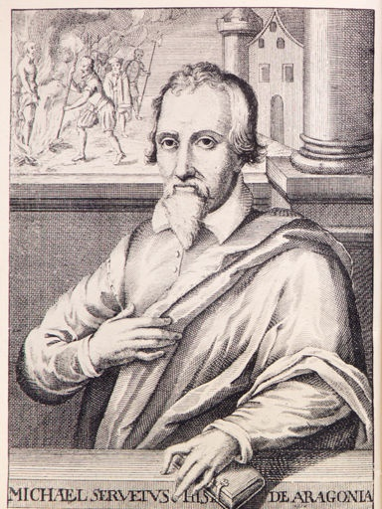
Michael Servetus
Michael Servetus (1509 - 1553), was opposed to the doctrine of the trinity.
A medical doctor of fame
He maintained that the Trinity was not based on scripture but on teachings of (Greek) philosophers.
Servetus affirmed that the Logos was a manifestation of God and not a separate divine person

Slide 48
Michael Servetus
He taught that it was from conception, the Son existed as “the only begotten of the Father.
The Son was not eternal, only the Logos, or the spoken words of God.
In 1531, he published a book: On the Errors of the Trinity. Servetus hoped his book would persuade believers to re-think the ‘Trinitarian’ doctrine.
On a charge by John Calvin, the Council of Geneva condemned Servetus of anti-trinitarianism, and ordered him burned at the stake.
Spectators were impressed by the tenacity of Servetus' faith as he perished in the flames

Slide 49
The Seven Periods In Church History
6) Period of Doctrinal Restoration – Part 1
A.D. 1828 - 1900
Edward Irving
Evan Roberts
Charles Parham
Stone’s Folly
This period covers A.D. 1828 to A.D. 1900

Slide 50
Edward Irving
Edward Irving was born, Scotland, August 4, 1792
He was a Presbyterian clergyman, ordained July 1822
His ministerial dream was to remodel men’s lives according to apostolic teachings
His lectures in 1828 packed the largest churches of Edinburgh in the early summer mornings
He possessed apostolic gifts of prophecy and healing
His believers “spoke with tongues
1. “Confidence" - A Pentecostal paper - 11 Park Lea Road, Sunderland,
England
2. Internet Wikipedia, free encyclopedia

Slide 51
Edward Irving
He was excommunicated by the presbytery in 1830, for publishing his doctrine regarding the humanity of Jesus Christ and his dual nature
Edward Irving was an exceptional speaker
In 1832 he removed to a new building in Newman Street, drawing consistent crowds
March 1833, he was deposed from the ministry by the Presbytry on charges of heresy
He died December 7,1834
• Gordon Strachan, The Pentecostal Theology of Edward Irving; London, 1973.
• Stunt, Timothy C.F., From Awakening to Secession, Radical Evangelicals in Switzerland and
Britain 1815-35, Edinburgh, T & T Clark, 2000 (402pp).

Slide 52
Seven Periods In Church History
7) Doctrinal Restoration
Part 2
A.D. 1906 - 2006
Evan Roberts
Charles Parham
W. Seymour
Frank Bartleman
This period covers A.D. 1906 to A.D. 2006

Slide 53
The Seven Periods In Church History
Important Events of The Period
Period of Doctrinal Restoration
Part 2
A.D. 1906 - 2006

Slide 54
Focus on Personnel
Charles Parham – Topeka, Kansas
Evan Roberts – Welsh Revival
W. J. Seymour – Azusa Street
W. H. Durham – Finish Work
R. E. McAllister – Arroyo Seco
Frank Ewart – Baptism in Jesus Name
Howard Goss - A promoter of Unity
Daniel C. O. Opperman – Assisted Goss
Glenn Cook – Baptized G. T. Haywood
G. T. Haywood – The Gifted Orator – Walking Bible

Slide 55
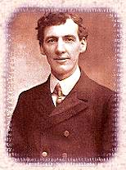
Evan Roberts
Sowed the seeds of the Welsh Revival of 1904
He did not possess the gifts of a great intellect or eloquent speech…
but simply a burning passion for Jesus
The role of Evan Roberts was anything but conventional. He would simply lead in prayer or read the Scriptures
Roberts was a constant example of how to be led by the Spirit

Slide 56
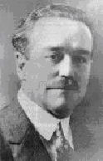
Charles F. Parham
Miraculously healed of Rheumatoid Arthritis
Charles F. Parham began his ministry at the age of 19
Through long hours of devoted prayer and intense study, the scriptures opened to him
He founded the Bethel Divine Healing House in 1898
Later he rented Stone’s Folly” and founded a Bible College

Slide 57
Charles F. Parham
He taught a return to the fundamental teachings of the Apostolic scriptures, and cleansing of the heart
January 1, 1901 Agnes Ozman received the Holy Ghost
Two days later Parham and several students received the Holy Ghost
Two weeks later, 34 students had been filled
Tongues as initial evidence of Holy Ghost

Slide 58
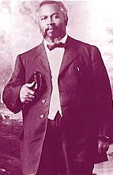
William J. Seymour
Charles Parham introduces William Seymour to the Holy Ghost
Invited to Los Angeles he preached one night that Tongues was the evidence
Locked out of the church he held house meetings at Bonnie Brae Street
The house was too small and he rented 312 Azusa Street
Seymour’s greatness can be found in his concern for spiritual empowerment

Slide 59
William J. Seymour
Great miracles were in evidence at Azusa
Commonly regarded as the beginning of the modern Pentecostal movement
Believed that the true church was being restored in an end-times miracle revival
He preached that tongues was the evidence of receiving the Holy Spirit.

Slide 60
William H. Durham
Pastor of North Avenue Mission - Chicago
He was a theologian considered without
equal Hundreds even thousands received the Holy Ghost there
Many notable preachers came and were filled
  One was E. N. Bell, a Baptist pastor – Fort Worth
Durham vigorously opposed the 2nd work of grace
He taught the “finished work of Calvary”
He filled the churches as he ministered in Los Angeles

Slide 61
R. E. McAlister
A Popular Evangelist – International Camp Meeting at Arroyo Seco, California
  364 had received the Holy Ghost
Preaching the Baptismal service His preliminary statement “All converts of the Book of Acts were baptized in the name of Jesus Christ”
It was said: “A shot was fired from Arroyo Seco at the International Camp meeting that was heard around the world!”
The future was set in concrete Baptism in the name of Jesus Christ was restored

Slide 62
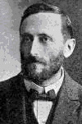
Frank Bartleman
Bartleman was a licensed Baptist preacher
Was an eyewitness to the early days of the Azusa Street Mission
He believed healing in the atonement and entire sanctification
Believed Baptism in the name of Jesus Christ as essential to salvation

Slide 63
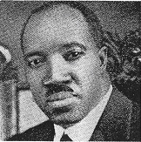
G. T. Haywood
Pastor of Christ temple
  Indianapolis, Indiana
Received the Holy Ghost at Main Street Mission
Was baptized in jesus name by Glen A. Cook
He was never a part of the Assemblies of God

Slide 64
Seven Periods In Church History
From the Merger to the Present
A.D. 1945 - 2006
Howard A. Goss
Arthur T. Morgan
Stanley W. Chambers
Nathaniel A. Urshan
Kenneth Haney

Slide 65
Merges To Create The UPC
1906 – Pentecostal Assemblies of the World Formed a Loose Ministerial Fellowship
1916 – AOG Forces a Withdrawal
1917 – General Assemblies of Apostolic Assemblies
1918 – GA of AA Merged With PAW
1925 – Three New Bodies: 1) AC of JC; PMA; and EC of JC
1927 – EM of JC Merged With AC of JC

Slide 66
Merges To Create The UPC
1931 – Four Oneness Organizations Met in Columbus, Ohio
1931 – The AC of JC merged with the PA of W to form the PA of JC
1932 – PMA Changed their Name to PCI
1936 – The PCI and the PA of JC voted to work toward a merge
1944 – First agreement was forged
and in…
1945 – The PCI and PA of JC merged
To form the UPC

Slide 67
Personnel From The Merge
Howard A. Goss
the first general superintendent of the United Pentecostal Church
In 1906 Goss was appointed field director of the Texas revivals
Howard Goss was one of three prime movers in organizing the Assemblies of God as a denomination in 1914

Slide 68
Steps That Created The UPC
Howard A. Goss, 1945-4951
United Pentecostal Church was formed in 1945
Through a merger of two Pentecostal groups:
the Pentecostal Church, Incorporated (PCI),
The Pentecostal Assemblies of Jesus Christ (PAJC)..

Slide 69
Merges To Create The UPC
Codes
PA of W
Pentecostal Assemblies of the World
GA of AA
General Assemblies of Apostolic Assemblies
AC of JC
Apostolic Assemblies of Jesus Christ
EC of JC
Emanuel Church of Jesus Christ
PMA
Pentecostal Ministerial Association
PA of JC
Pentecostal Assemblies of Jesus Christ
PCI
Pentecostal Churches Incorporated
(Feb.)
1925
1932
PMA
PCI
1945
1928
(Oct.)
UPC
1917
EC of JC
1931
AC of JC
1918
(Feb.)
1906
AC of JC
GA of AA
PA of JC
PA of W
PA of W
PA of W Continues

Slide 70
The Seven Periods In Church History
From the Merger to the Present
A.D. 1945 - 2006
Howard A. Goss
Arthur T. Morgan
Stanley W. Chambers
Nathaniel A. Urshan
Kenneth Haney

Slide 71

Howard A. Goss
Howard Goss was a key player in the early Pentecostal movement in North America
He was not a theological innovator. His gift was that of organization
He was instrumental in the formation of at least ten Pentecostal organizations

Slide 72
Howard A. Goss
Was elected to serve as the First General Superintendent during the merge of 1945.
He served until 1951

Slide 73
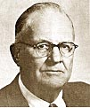
Arthur T. Morgan
Was elected general Superintendent in 1951
  He died in 1967 during the General Conference

Slide 74

Oliver Fauss
Was appointed to serve as the unfulfilled term of General Superintendent when Arthur T. Morgan died
Stanley Chambers was duly elected the next conference

Slide 75

Stanley W. Chambers
Was elected General superintendent in 1968
  He served until 1977.

Slide 76

Nathaniel A. Urshan
Was elected the General Superintendent in 1977
  He served until 2002
He was the son of an early Oneness leader, A. D. Urshan.

Slide 77

Kenneth Haney
Was elected the General Superintendent in 2002, and is presently serving as the
He was also the son of an early Oneness leader, Clyde Haney

Slide 78
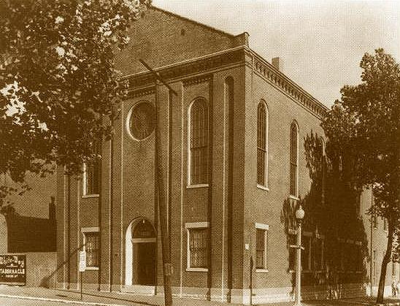
Whiteway Tabernacle
The St. Louis place of the Merger in 1945
A Tremendous move of God permeated the atmosphere of the Merger
Both the PCI and the PA of JC were ready to create a vehicle of evangelism

Slide 79
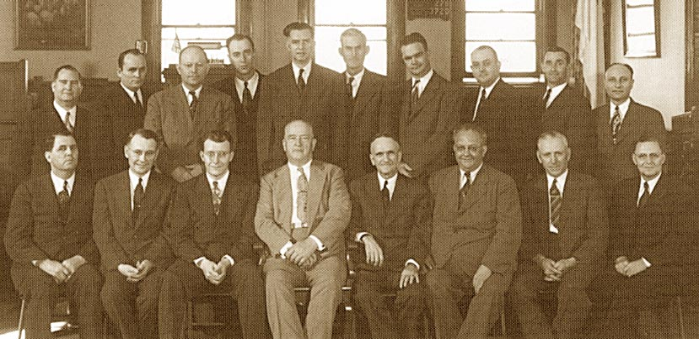
First General Board

